Slide 1

Logistic Regression Explained
1 Definition
2 Equation
3 Geometrical Representation
4 Where to use?
5 Code Implementation

Slide 2
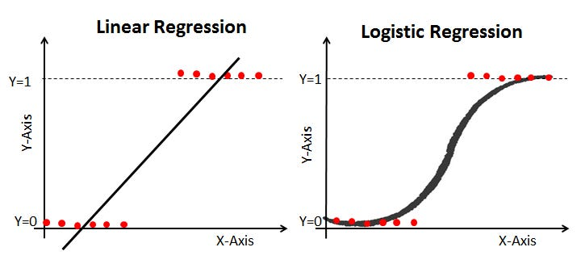

Logistic Regression: Definition
Logistic Regression is a supervised machine learning algorithm used for classification problems.
Even though it has “regression” in its name, it is not used for regression tasks (predicting continuous values). Instead, it predicts the probability of a categorical dependent variable. It’s most commonly used for binary classification (like yes/no, 0/1, true/false).

Slide 3
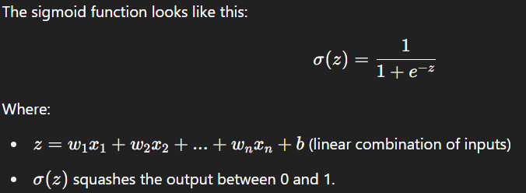
Logistic Regression: Equation
Key Idea
Logistic Regression uses a logistic (sigmoid) function to map predicted values to probabilities between 0 and 1. If the probability is above a threshold (usually 0.5), it classifies the outcome as one class (e.g., 1), else as the other class (e.g., 0).
The sigmoid function looks like this:
Age (x1) | Salary (x2) | Outcome
30 | 100 | 0
Z =w1.x1 + w2.x2 + … + wn.xn
Z =(2.30) + (2.100) + 1
Z =(60) + (200) + 1
Z =261
(z) = 1 / (1 + e-261) = 0

Slide 4
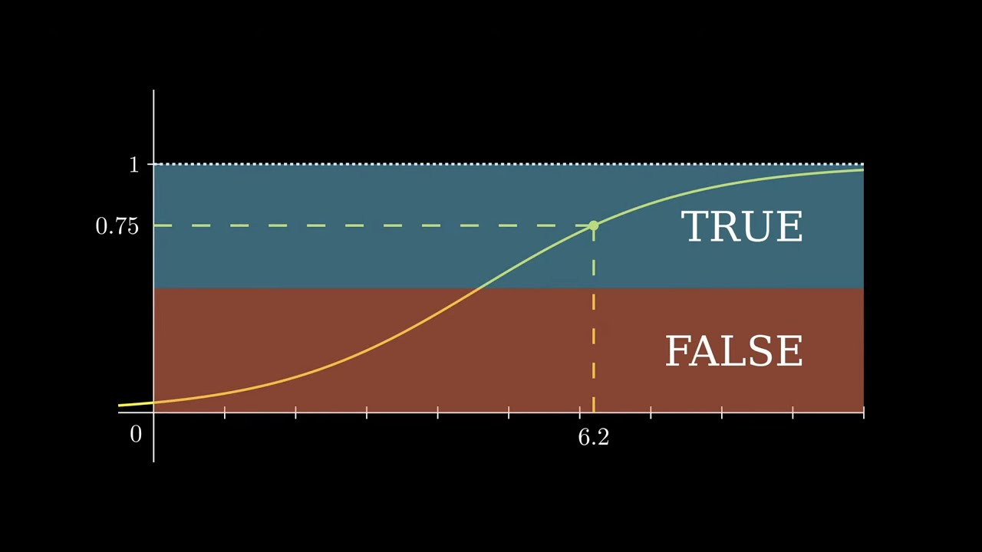




Geometrical Representation

Slide 5
Where is Logistic Regression Used?
Predicting if an email is spam or not
Medical diagnosis (e.g., disease present or not)
Customer churn (will a customer leave?)
Sentiment analysis (positive/negative)

